Slide 1
Overall Project Design
Google Classroom 101 Module
The topic I have chosen to focus on is Google Classroom. I chose this topic because of the usefulness of this platform for teachers in grades 3-5. With the rise of remote or hybrid learning models over the past few years, there has been a need for a consistent learning management system for teachers to use that is reliable, secure, and age appropriate for students.
I believe that Google Classroom has the potential to meet all of these requirements, and while it certainly is used in secondary education, it can be used very easily in elementary classrooms. I teach in a third grade classroom, and have have experienced much success with using it to meet the needs of diverse learners. That said, when I speak with my colleagues, many use it very sparingly, or not at all, in favor of traditional paper and pencil curriculum materials. Any technology use in the classroom doesn’t go outside of the confines of word processing or learning games on various websites. A reliable learning management system that is outfitted with different accessibility features and used in conjunction with the active learning of the physical environment can have a positive impact on student outcomes. (Bradley, 2021).
This course will be administered to fellow professionals in my learning community, namely teachers that teach grades 3-5. This will be included as a professional development opportunity for teachers wishing to become more well versed in using Google Classroom in a remote or hybrid classroom. The content for this course will also be done within the Google Classroom platform itself.
Design choices:
Color scheme (include examples or hex numbers):
Images will be related to the interface of Google Classroom, as screenshots of the platform and screencasts of the software in use will be used. I will create a sample classroom for presentations that will use a fairly simple color scheme, which includes blue accents with a white background. The blue and white colors will also be used with any assessments. The presentation themes will use the same colors.
Font styles, sizes, colors (include font style name, size, and color for each element):
Heuristica for headings, OpenSans Condensed for information, white and black font, various sizes (34 for headings, 18 for information)
Users will be able to navigate the slides using the arrow keys and clicking. The screencasts will feature a play button.
Additional Developer Notes:
Notes:
This slide will present a high-level overview of your project. The module title should be entered into the Project Title space. This should be the title that displays at the beginning of your module.
In the Project Purpose area, describe the intended purpose of the module, why is it being developed and for whom.
In the Design Choices section, clearly describe the color choices that will make up the design of the module. Include colors for background, fonts, shapes (like headers and navigational areas), hyperlinks, buttons, and any other decorative elements that might be included. Hex numbers can be found at http://www.color-hex.com. Next, include the font style names you will use in your design. Indicate the name, color, and font size for each element. You will need to identify choices for titles, content text, navigation text, and button text (if applicable).
In the Navigation section, describe how users will navigate through your module. Indicate if there will be a navigation pane and where on the page it should be located. If there will be button navigation, describe the buttons and where they are located on each page. Navigation should be consistent from page to page throughout the module.
In the Additional Developer Notes section, provide any additional information that might be necessary such as the need to record voice-overs for several slides or additional graphic or multimedia development that might be needed.

Slide 2
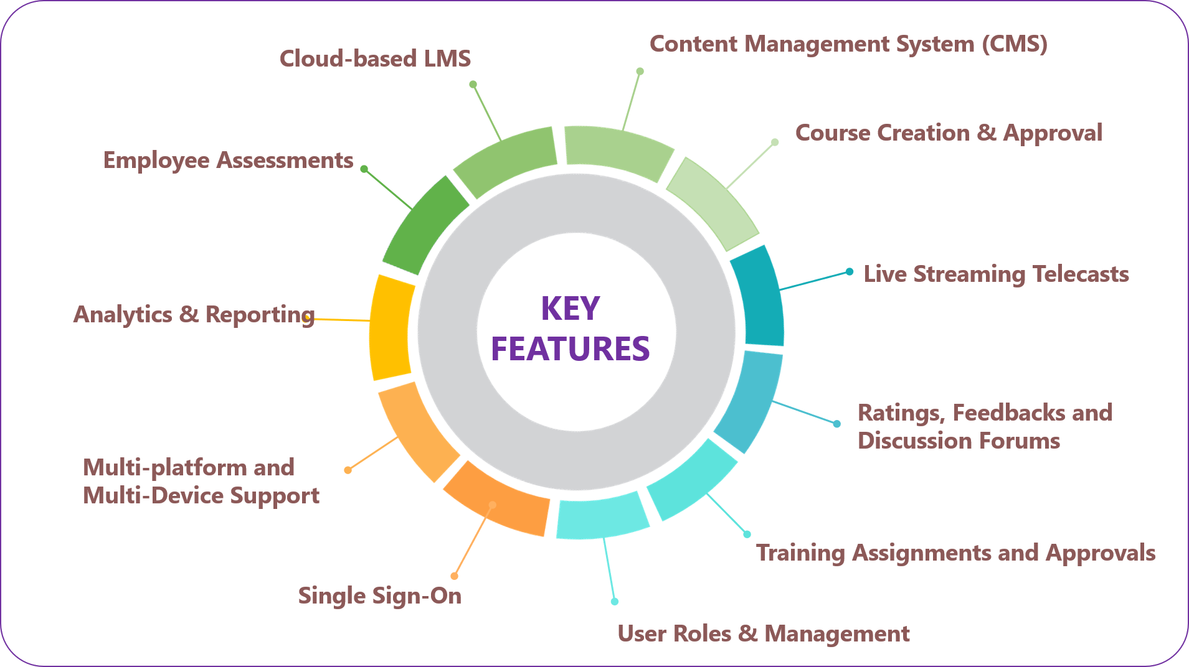
Content Slide #1.1
Introduction to Learning Management Systems
Learning Management Systems (LMS), when paired with the physical learning environment, have the potential to improve student learning outcomes, and increase teacher self-efficacy, and reduce the workload for teachers when used effectively. The advantages of a reliable LMS are profound.
When users click on “Introduction to Learning Management Systems”, there will be a zoom animation that takes them to the first content slide for this topic. This visual will be presented. Upon clicking again, the words will appear. A subsequent click will take the learner to the next content slide for this sub-topic.
Notes:
In the Content Slide # section, indicate the slide number. If you are breaking your module into separate sections number the slides as appropriate (ie. Slide 1.2 or Slide 3.5, etc.)
Input the title of the slide as it will display in the module.
In the On Screen Content section, provide the text that should display on this slide or other multimedia elements that should be included.
Provide any proposed images or graphics that should be included. Provide the source URL for the images for copyright purposes.
In the Audio Narration section, provide the complete narration script (if needed) for this slide. The narration script should be fully written out so that it might be recorded by another person.
In the Interactivity section, describe any type of interactivity that should be included on this slide. Describe any needed animations that will display as well. Explain any branching scenarios that you might include per the example provided.
Repeat the use of this slide template for all content slides in the module.

Slide 3



Content Slide #1.2
Introduction to Learning Management Systems
Academic LMS Corporate LMS Learning Content Management Systems (LCMS)
Learning Management Systems are used in the corporate world and in academics. The features of an LMS are different depending on the environment they are used for. There are three main types of Learning Management Systems: Academic Learning Management Systems, Corporate Learning Management Systems, and Learning Content Management Systems. The purposes of each are different, but the LMS we will be focusing on is an Academic LMS
Clicking on the icon for each type of LMS will allow the learner to read a description of the purposes and uses of that type of LMS. Examples of those types of LMS will also be shown.
Notes:
In the Content Slide # section, indicate the slide number. If you are breaking your module into separate sections number the slides as appropriate (ie. Slide 1.2 or Slide 3.5, etc.)
Input the title of the slide as it will display in the module.
In the On Screen Content section, provide the text that should display on this slide or other multimedia elements that should be included.
Provide any proposed images or graphics that should be included. Provide the source URL for the images for copyright purposes.
In the Audio Narration section, provide the complete narration script (if needed) for this slide. The narration script should be fully written out so that it might be recorded by another person.
In the Interactivity section, describe any type of interactivity that should be included on this slide. Describe any needed animations that will display as well. Explain any branching scenarios that you might include per the example provided.
Repeat the use of this slide template for all content slides in the module.

Slide 4

Content Slide #1.3
Introduction to Learning Management Systems
Academic LMS Corporate LMS Learning Content Management Systems (LCMS)
Academic LMS are intended for the classroom environment. The administrator of an academic LMS is the teacher, while the users are the students. An academic LMS includes grading features, and grants the administrator of the LMS to create multimedia learning activities. An example of an academic LMS would be Canvas. Corporate LMS are used in a corporate setting. The administrator of the corporate LMS is usually the manager, HR representative, or employee in charge of training other employees. Corporate LMS are used to house learning material for continuing education or training for employees so companies can remain in compliance. An example of a corporate LMS is talentLMS. Finally, LCMS allow administrators to author learning content, and many users can use these platforms. EdApp is an example of an LCMS.
There are no activities for this slide.Clicking again on this slide again will take the user back to the home page of the presentation.
Notes:
In the Content Slide # section, indicate the slide number. If you are breaking your module into separate sections number the slides as appropriate (ie. Slide 1.2 or Slide 3.5, etc.)
Input the title of the slide as it will display in the module.
In the On Screen Content section, provide the text that should display on this slide or other multimedia elements that should be included.
Provide any proposed images or graphics that should be included. Provide the source URL for the images for copyright purposes.
In the Audio Narration section, provide the complete narration script (if needed) for this slide. The narration script should be fully written out so that it might be recorded by another person.
In the Interactivity section, describe any type of interactivity that should be included on this slide. Describe any needed animations that will display as well. Explain any branching scenarios that you might include per the example provided.
Repeat the use of this slide template for all content slides in the module.

Slide 5
Assessment Slide #1
Introduction to Learning Management Systems
Dragging and dropping will be used to assess understanding.
Academic LMS Corporate LMS LCMS
Used mainly in corporate environments Used in academic environments
Administrator is a teacher or instructor Administrator is HR representative
Includes additional content creation features for users on top of a traditional corporate LMS
This is a matching exercise. Learners will need to drag and drop the characteristics of each LMS into a corresponding box.
A link to this activity will be included in the presentation. Clicking again on this slide again will take the user back to the home page of the presentation.
Notes:
In the Content Slide # section, indicate the slide number. If you are breaking your module into separate sections number the slides as appropriate (ie. Slide 1.2 or Slide 3.5, etc.)
Input the title of the slide as it will display in the module.
In the On Screen Content section, provide the text that should display on this slide or other multimedia elements that should be included.
Provide any proposed images or graphics that should be included. Provide the source URL for the images for copyright purposes.
In the Audio Narration section, provide the complete narration script (if needed) for this slide. The narration script should be fully written out so that it might be recorded by another person.
In the Interactivity section, describe any type of interactivity that should be included on this slide. Describe any needed animations that will display as well. Explain any branching scenarios that you might include per the example provided.
Repeat the use of this slide template for all content slides in the module.

Slide 6
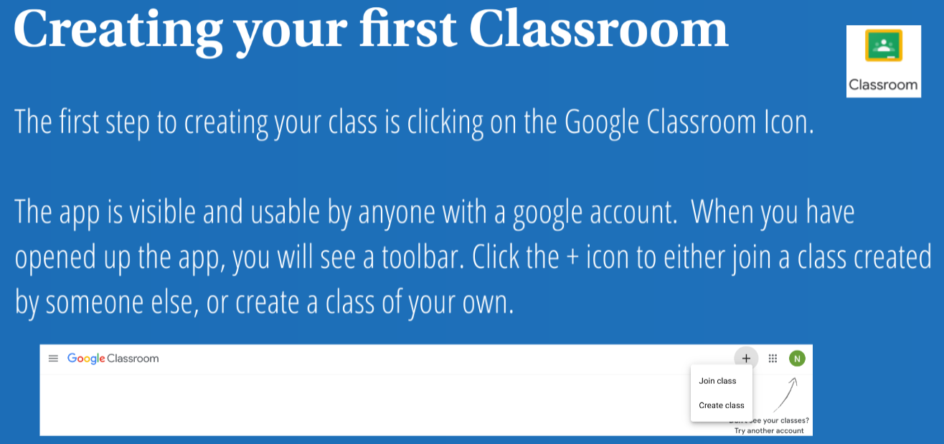

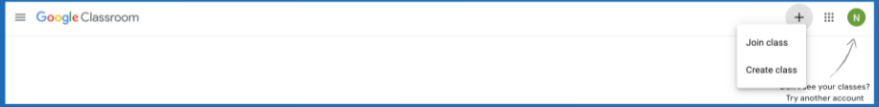
Content Slide #2.1
Creating your First Classroom
Proposed image or graphic for this slide
The first step to creating your class is to click on the Google Classroom Icon, which can be found by clicking on the waffle icon after you have made a google account. The app is visible and usable after the account has been created. Click the + icon to create your own class or join a class.
There are no activities for this slide. Clicking on the Google Classroom icon will take the learner to classroom.google.com which will allow them to begin the process of creating their own class.
Notes:
In the Content Slide # section, indicate the slide number. If you are breaking your module into separate sections number the slides as appropriate (ie. Slide 1.2 or Slide 3.5, etc.)
Input the title of the slide as it will display in the module.
In the On Screen Content section, provide the text that should display on this slide or other multimedia elements that should be included.
Provide any proposed images or graphics that should be included. Provide the source URL for the images for copyright purposes.
In the Audio Narration section, provide the complete narration script (if needed) for this slide. The narration script should be fully written out so that it might be recorded by another person.
In the Interactivity section, describe any type of interactivity that should be included on this slide. Describe any needed animations that will display as well. Explain any branching scenarios that you might include per the example provided.
Repeat the use of this slide template for all content slides in the module.

Slide 7
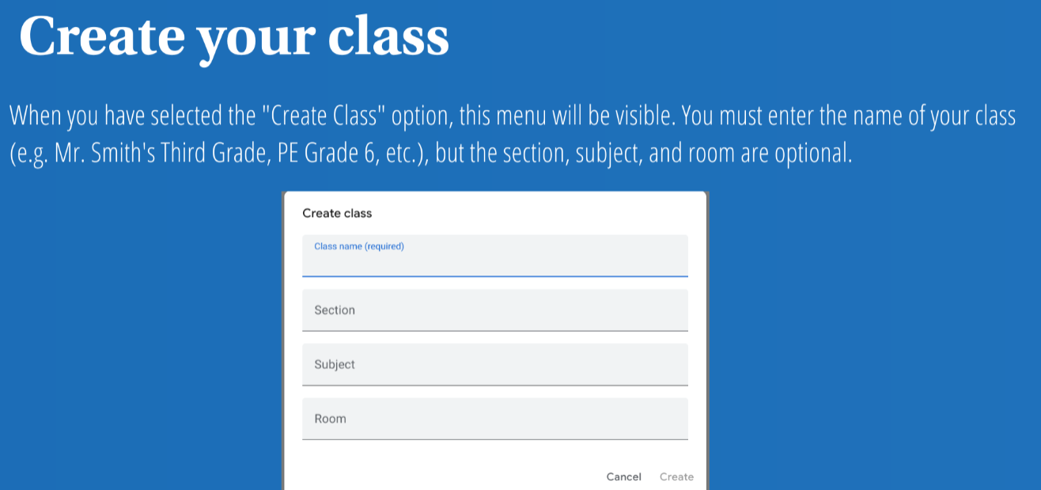
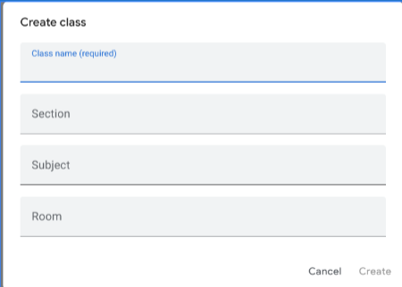
Content Slide #2.2
Creating your First Classroom
Proposed image or graphic for this slide
This menu will allow you to create your class. Enter the name of your class. The section, subject, and room are optional.
Clicking on this slide will take you to the next slide.
Notes:
In the Content Slide # section, indicate the slide number. If you are breaking your module into separate sections number the slides as appropriate (ie. Slide 1.2 or Slide 3.5, etc.)
Input the title of the slide as it will display in the module.
In the On Screen Content section, provide the text that should display on this slide or other multimedia elements that should be included.
Provide any proposed images or graphics that should be included. Provide the source URL for the images for copyright purposes.
In the Audio Narration section, provide the complete narration script (if needed) for this slide. The narration script should be fully written out so that it might be recorded by another person.
In the Interactivity section, describe any type of interactivity that should be included on this slide. Describe any needed animations that will display as well. Explain any branching scenarios that you might include per the example provided.
Repeat the use of this slide template for all content slides in the module.

Slide 8
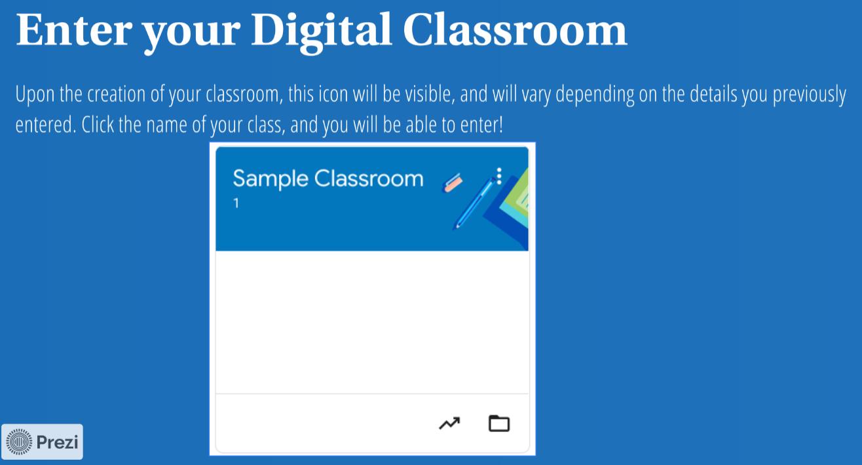
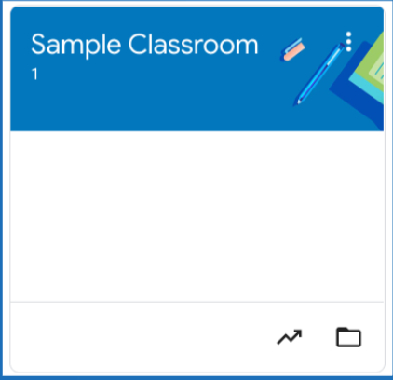
Content Slide #2.3
Creating your First Classroom
Proposed image or graphic for this slide
When your classroom is created, you will see this icon. Click on the name of your classroom and you will be able to enter!
Clicking on this slide will begin a pan out animation and take you back to the homepage of the presentation.
Notes:
In the Content Slide # section, indicate the slide number. If you are breaking your module into separate sections number the slides as appropriate (ie. Slide 1.2 or Slide 3.5, etc.)
Input the title of the slide as it will display in the module.
In the On Screen Content section, provide the text that should display on this slide or other multimedia elements that should be included.
Provide any proposed images or graphics that should be included. Provide the source URL for the images for copyright purposes.
In the Audio Narration section, provide the complete narration script (if needed) for this slide. The narration script should be fully written out so that it might be recorded by another person.
In the Interactivity section, describe any type of interactivity that should be included on this slide. Describe any needed animations that will display as well. Explain any branching scenarios that you might include per the example provided.
Repeat the use of this slide template for all content slides in the module.

Slide 9
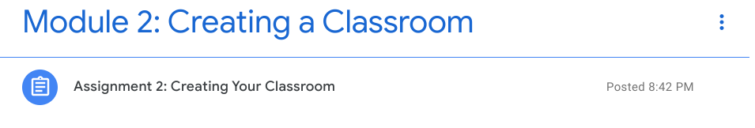
Assessment Slide #2
Creating your First Classroom
This activity will be accompanied by a Screencast. The student will create a classroom for a topic of their choice. The learner will submit a screenshot of the homepage to show their created classroom.
This activity includes 2 components: A screencast, and a corresponding activity. The activity will involve the student taking a screenshot of their created course from the homepage of their own Google Classroom account.
This activity will be housed in Google Classroom.
Notes:
In the Content Slide # section, indicate the slide number. If you are breaking your module into separate sections number the slides as appropriate (ie. Slide 1.2 or Slide 3.5, etc.)
Input the title of the slide as it will display in the module.
In the On Screen Content section, provide the text that should display on this slide or other multimedia elements that should be included.
Provide any proposed images or graphics that should be included. Provide the source URL for the images for copyright purposes.
In the Audio Narration section, provide the complete narration script (if needed) for this slide. The narration script should be fully written out so that it might be recorded by another person.
In the Interactivity section, describe any type of interactivity that should be included on this slide. Describe any needed animations that will display as well. Explain any branching scenarios that you might include per the example provided.
Repeat the use of this slide template for all content slides in the module.

Slide 10
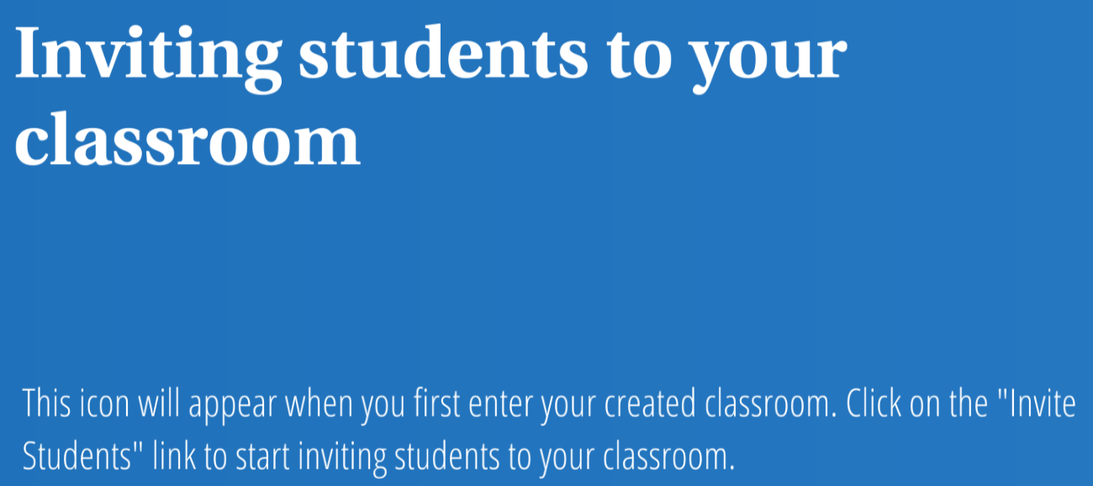
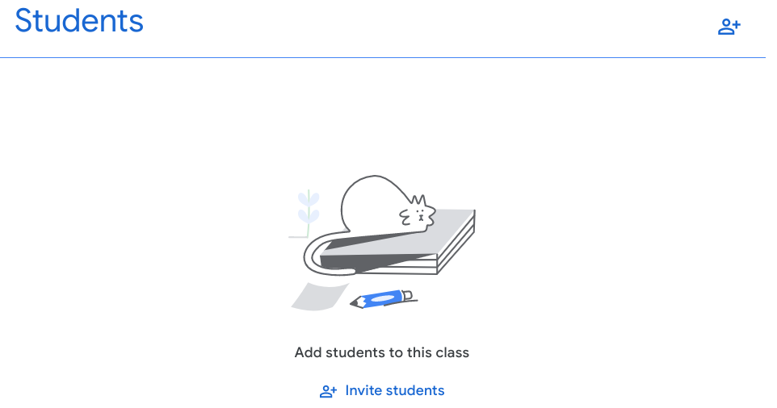
Content Slide #3.1
Inviting and Onboarding Students
On screen content (What will display on this screen?)
Proposed image or graphic for this slide
When you have created your classroom, you will now need to start inviting students. Click “Invite Students” to begin the next step.
Another click will initiate a zoom in animation and then the next slide will be presented.
Notes:
In the Content Slide # section, indicate the slide number. If you are breaking your module into separate sections number the slides as appropriate (ie. Slide 1.2 or Slide 3.5, etc.)
Input the title of the slide as it will display in the module.
In the On Screen Content section, provide the text that should display on this slide or other multimedia elements that should be included.
Provide any proposed images or graphics that should be included. Provide the source URL for the images for copyright purposes.
In the Audio Narration section, provide the complete narration script (if needed) for this slide. The narration script should be fully written out so that it might be recorded by another person.
In the Interactivity section, describe any type of interactivity that should be included on this slide. Describe any needed animations that will display as well. Explain any branching scenarios that you might include per the example provided.
Repeat the use of this slide template for all content slides in the module.

Slide 11
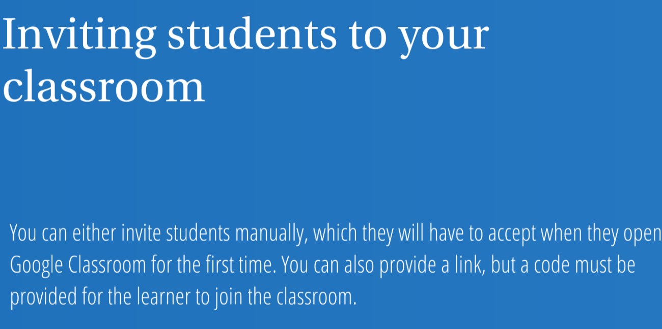
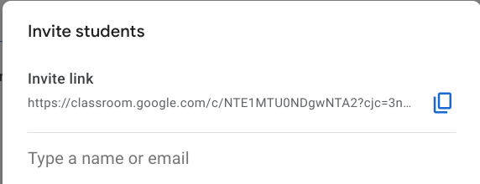
Content Slide #3.2
Inviting and Onboarding Students
On screen content (What will display on this screen?)
Proposed image or graphic for this slide
It is advised that for younger students, you manually enter their information in prior to onboarding them onto Google Classroom. This will reduce the time needed to onboard, as opposed to sending an invite link and providing a code.
Another click will pan out to the homepage again.
Notes:
In the Content Slide # section, indicate the slide number. If you are breaking your module into separate sections number the slides as appropriate (ie. Slide 1.2 or Slide 3.5, etc.)
Input the title of the slide as it will display in the module.
In the On Screen Content section, provide the text that should display on this slide or other multimedia elements that should be included.
Provide any proposed images or graphics that should be included. Provide the source URL for the images for copyright purposes.
In the Audio Narration section, provide the complete narration script (if needed) for this slide. The narration script should be fully written out so that it might be recorded by another person.
In the Interactivity section, describe any type of interactivity that should be included on this slide. Describe any needed animations that will display as well. Explain any branching scenarios that you might include per the example provided.
Repeat the use of this slide template for all content slides in the module.

Slide 12
Assessment Slide #3
Inviting and Onboarding Students
Copy and paste your invite link into the Google Classroom for this course.
This assessment is intended to allow learners to share the link to their respective classrooms. Copying and pasting the link is all that they will need to do.
The learner will need to copy and paste their link in the stream of the Google Classroom course.
This activity will be housed in Module 3 of Google Classroom.
Notes:
In the Content Slide # section, indicate the slide number. If you are breaking your module into separate sections number the slides as appropriate (ie. Slide 1.2 or Slide 3.5, etc.)
Input the title of the slide as it will display in the module.
In the On Screen Content section, provide the text that should display on this slide or other multimedia elements that should be included.
Provide any proposed images or graphics that should be included. Provide the source URL for the images for copyright purposes.
In the Audio Narration section, provide the complete narration script (if needed) for this slide. The narration script should be fully written out so that it might be recorded by another person.
In the Interactivity section, describe any type of interactivity that should be included on this slide. Describe any needed animations that will display as well. Explain any branching scenarios that you might include per the example provided.
Repeat the use of this slide template for all content slides in the module.

Slide 13
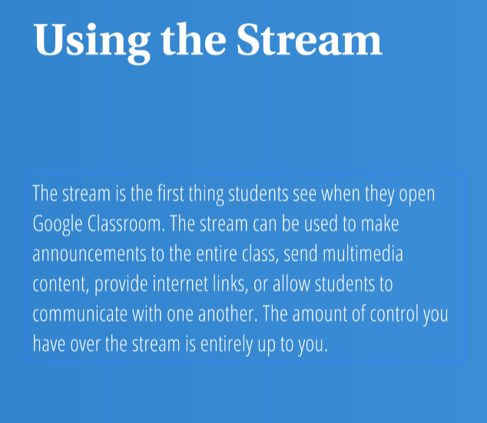
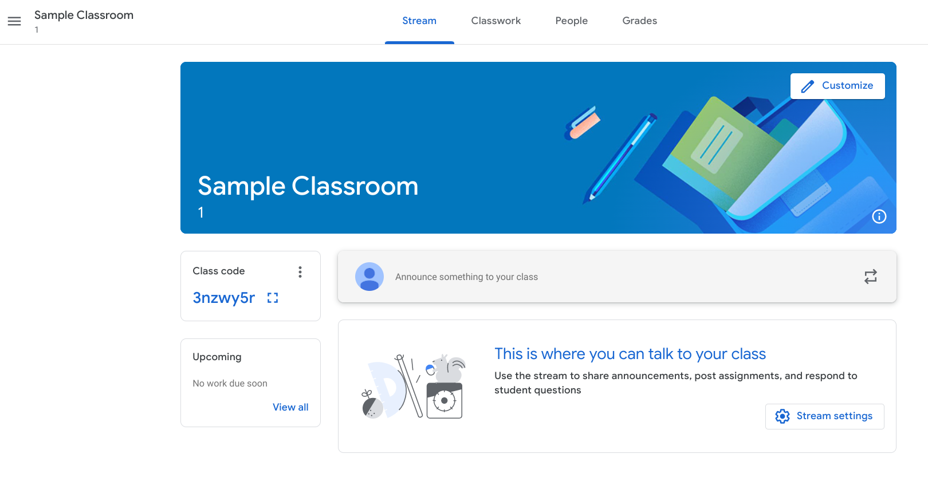
Content Slide #4.1
Using the Stream
Proposed image or graphic for this slide
The stream functions like a news feed, similar to a social media platform. Important announcements or posts can be pinned to the top of the stream so that is the first thing learners see when the classroom is entered. You have the ability to limit the type of posts learners in the classroom can do. You can control whether students can post in the stream without your approval, or limit their ability to reply to each other’s posts. You can post announcements and links to videos or websites in the stream as well.
No activities are associated with this content slide. Clicking will transition to the next content slide of this presentation.
Notes:
In the Content Slide # section, indicate the slide number. If you are breaking your module into separate sections number the slides as appropriate (ie. Slide 1.2 or Slide 3.5, etc.)
Input the title of the slide as it will display in the module.
In the On Screen Content section, provide the text that should display on this slide or other multimedia elements that should be included.
Provide any proposed images or graphics that should be included. Provide the source URL for the images for copyright purposes.
In the Audio Narration section, provide the complete narration script (if needed) for this slide. The narration script should be fully written out so that it might be recorded by another person.
In the Interactivity section, describe any type of interactivity that should be included on this slide. Describe any needed animations that will display as well. Explain any branching scenarios that you might include per the example provided.
Repeat the use of this slide template for all content slides in the module.

Slide 14

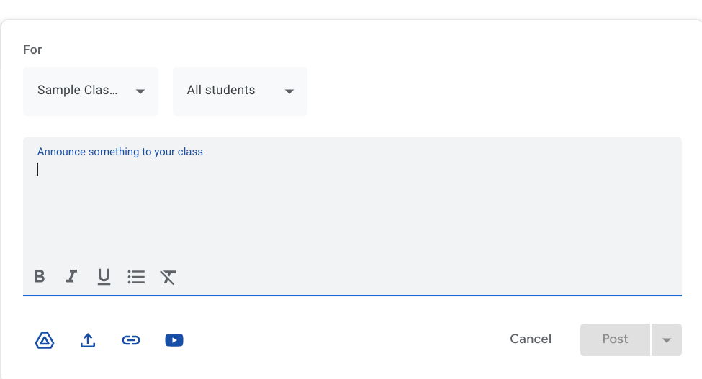
Content Slide #4.2
Using the Stream
Proposed image or graphic for this slide
The visibility of the stream posts can be customized. You can choose to send the stream post to multiple classes at a time, all of the students in a particular class, or send announcements or messages to groups of students or individuals if necessary. Files, video links, youtube videos, and links to Slides, Docs, or Sheets in Google Suite for Learning can be included in a stream post.
There will be a link to presentation slides for the different subcategories of stream posts. Google Drive Compatibility, Files, Links, and Videos will be explained.
Notes:
In the Content Slide # section, indicate the slide number. If you are breaking your module into separate sections number the slides as appropriate (ie. Slide 1.2 or Slide 3.5, etc.)
Input the title of the slide as it will display in the module.
In the On Screen Content section, provide the text that should display on this slide or other multimedia elements that should be included.
Provide any proposed images or graphics that should be included. Provide the source URL for the images for copyright purposes.
In the Audio Narration section, provide the complete narration script (if needed) for this slide. The narration script should be fully written out so that it might be recorded by another person.
In the Interactivity section, describe any type of interactivity that should be included on this slide. Describe any needed animations that will display as well. Explain any branching scenarios that you might include per the example provided.
Repeat the use of this slide template for all content slides in the module.

Slide 15
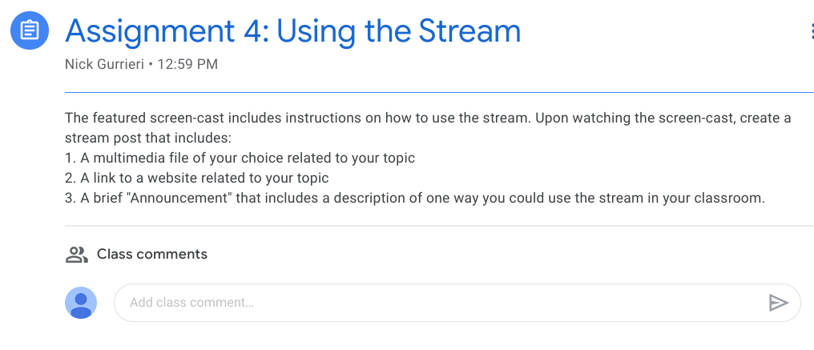
Assessment Slide #4
Using the Stream
This activity will be accompanied by a Screencast. The student will create a stream post related to the topic of their choice, and then post the content on their stream that includes the information included in the screen-cast.
This activity will be created within the Google Classroom Stream that the administrator will be able to see following the activity on Assessment Slide 3.
This activity can be found on Module 4 of Google Classroom
Notes:
In the Content Slide # section, indicate the slide number. If you are breaking your module into separate sections number the slides as appropriate (ie. Slide 1.2 or Slide 3.5, etc.)
Input the title of the slide as it will display in the module.
In the On Screen Content section, provide the text that should display on this slide or other multimedia elements that should be included.
Provide any proposed images or graphics that should be included. Provide the source URL for the images for copyright purposes.
In the Audio Narration section, provide the complete narration script (if needed) for this slide. The narration script should be fully written out so that it might be recorded by another person.
In the Interactivity section, describe any type of interactivity that should be included on this slide. Describe any needed animations that will display as well. Explain any branching scenarios that you might include per the example provided.
Repeat the use of this slide template for all content slides in the module.

Slide 16
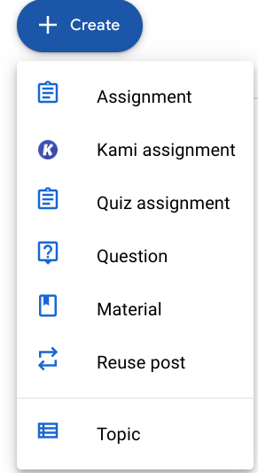
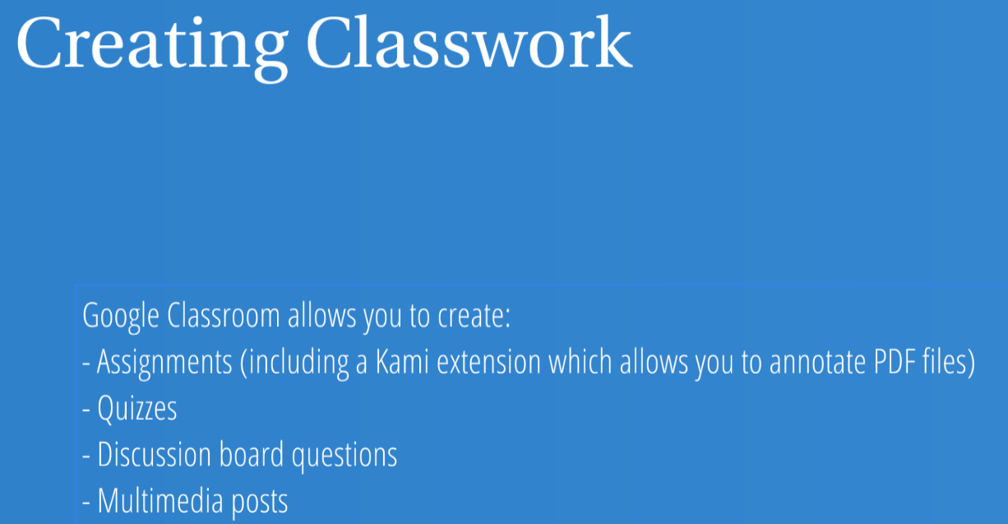
Content Slide #5
Creating Classwork
On screen content (What will display on this screen?)
Proposed image or graphic for this slide
Google Classroom has a “Classwork” section as well. This section allows the LMS administrator to create learning activities in the form of assignments, quizzes, discussion board posts, and informational material. You also have the ability to create topics, and those topics can be used to categorize related subject matter and activities related to certain topics. Also, if you have created a classroom previously, or are a co administrator with another instructor, you can reuse material from a different class to help you save time in creating new content.
There will be a link to presentation slides for the different subcategories of classwork posts. Assignments, Kami Assignments, Quiz Assignments, Questions, Material, and Topics will be discussed in subsequent slides.
Notes:
In the Content Slide # section, indicate the slide number. If you are breaking your module into separate sections number the slides as appropriate (ie. Slide 1.2 or Slide 3.5, etc.)
Input the title of the slide as it will display in the module.
In the On Screen Content section, provide the text that should display on this slide or other multimedia elements that should be included.
Provide any proposed images or graphics that should be included. Provide the source URL for the images for copyright purposes.
In the Audio Narration section, provide the complete narration script (if needed) for this slide. The narration script should be fully written out so that it might be recorded by another person.
In the Interactivity section, describe any type of interactivity that should be included on this slide. Describe any needed animations that will display as well. Explain any branching scenarios that you might include per the example provided.
Repeat the use of this slide template for all content slides in the module.

Slide 17
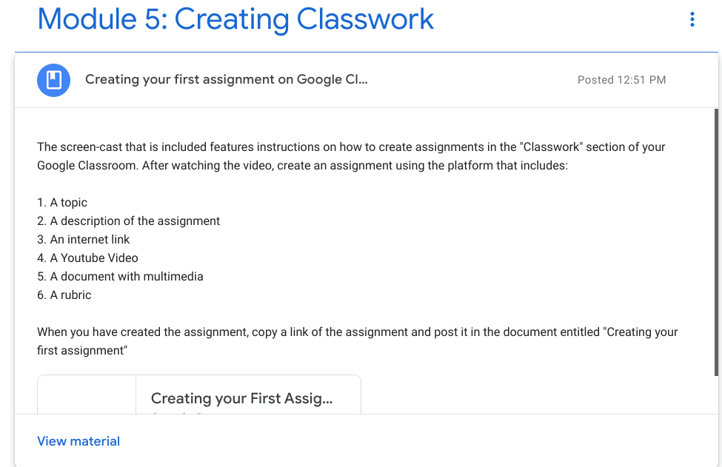
Assessment Slide #5
Creating Classwork
This activity will be accompanied by a Screencast. The student will create an activity related to the topic of their choice, and then post a link to the activity within a shared document in the module.
This activity includes 2 components: A screencast, and a corresponding activity. The activity will involve the student creating an activity that covers all the aspects of assignment creation detailed in the screencast.
This activity will be housed in Google Classroom in it’s own module.
Notes:
In the Content Slide # section, indicate the slide number. If you are breaking your module into separate sections number the slides as appropriate (ie. Slide 1.2 or Slide 3.5, etc.)
Input the title of the slide as it will display in the module.
In the On Screen Content section, provide the text that should display on this slide or other multimedia elements that should be included.
Provide any proposed images or graphics that should be included. Provide the source URL for the images for copyright purposes.
In the Audio Narration section, provide the complete narration script (if needed) for this slide. The narration script should be fully written out so that it might be recorded by another person.
In the Interactivity section, describe any type of interactivity that should be included on this slide. Describe any needed animations that will display as well. Explain any branching scenarios that you might include per the example provided.
Repeat the use of this slide template for all content slides in the module.

Slide 18
References
Bradley, V. M. (2021). Learning Management System (LMS) use with online instruction. International Journal of Technology in Education (IJTE), 4(1), 68-92. https://doi.org/10.46328/ijte.36

